Slide 1
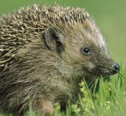
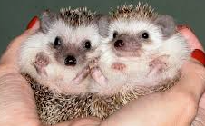


Welcome to Year 1 Hedgehog’s
‘Meet the Teacher’

Slide 2

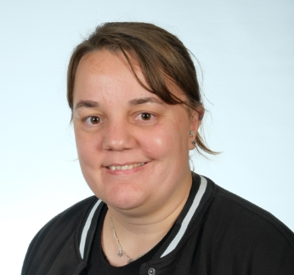
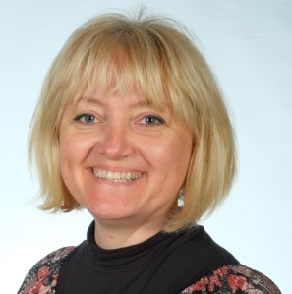
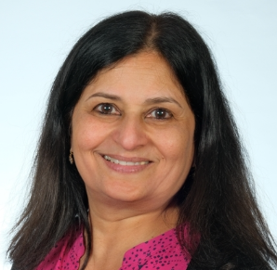
Meet the staff
Class Teacher:
Miss Bryan
TA:
Mrs Nair
Music Teacher:
Mrs Tatarczyk
PE Teacher:
Mr O’Shea

Slide 3
Timings of the day
The school opens at 8.35. We use this 'soft start' time in the morning to support children and get them ready for the day so that we can start lessons promptly at 8.45.
The school gates will close at 8.45 sharp. Any children arriving after this time must report as late through the front office.
Parents and Carers leave children at the building door. If you have a message, please pass it on either to the Support staff on the door, or to the main school office.

Slide 4
Timings of the day
Playtime in Year 1 is at 10:15
Lunch time is 12:00
Home time is 3:30pm , Wednesday is 2:15pm

Slide 5
Uniform and PE kits
At Foxborough, we have high expectations for school uniform.
Full school uniform must be worn each day, unless you have been informed of a special day.
Uniform includes black shoes (no trainer, no logos).
PE kits should be worn to school on PE days. Our PE days are Tuesday and Thursday.
Jewellery is not permitted at school. For safety reasons, earrings must be removed for PE lessons.
Children not in the correct uniform will receive a letter for their parents.
We hold uniform swap shops regularly where families can buy second-hand uniform
If you are struggling to provide the correct uniform please contact Mrs Foster (advice@foxboroughprimary.co.uk)

Slide 6

Values
These are our school values. These are well-embed in our school culture and form the basis of everything we do.
Can you think of when we use or talk about our ROCK values?

Slide 7
ROCK curriculum
This year we will follow our ROCK curriculum to develop our values through a class project. We will present these to families in an exhibition at the end of the year.
ROCK electives
We will also be offering children the opportunity to choose a sports or arts based class to join in two terms throughout the year.
The skills we are developing this half term are:
R – Healthy Eating Choices
O – What’s in my local area? Finding a cause
C – Resilience
K – Labelling different emotions

Slide 8
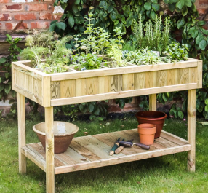
Our year group responsibility is...
Taking care of our garden.

Slide 9
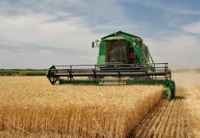
Our school performance will be...
The Harvest Production in October.

Slide 10

Our year group opportunity is...
Karate in Spring Term

Slide 11
Behaviour - ROCK points
This year we will be introducing ROCK reward points for their House teams.
Children can earn ROCK points for demonstrating each of the 4 values.
Can you earn each of your badges and become a ROCKstar before the end of the year?!

Slide 12




Behaviour - ROCK points for your team

Slide 13

Behaviour - responses
On the rare occasion it is necessary, a Response 1, 2 or 3 by be used as point for children to reflect on their behaviour and to discuss their behaviour with an adult.
We have high expectations of our children and responses will be only be issued after a number of reminders have been given and children have had the opportunity to ‘repair’ the situation.

Slide 14
Behaviour - responses
If a response needs to be issued they will follow this format:
Response 1 – Verbal warning
Response 2 – Class-based consequence
Response 3 – Further support such as another member of staff to come into class or the child visits another member of staff (10 mins max).
You will receive a text if your child is issued with a response and any child issued a Response 3 will require you to have meeting with the class teacher to plan how we can together support your children in making the right choices going forward.

Slide 15

Zones of regulation toolkits
We teach children to recognise how they are feeling so that they can learn to self-regulate.

Slide 16
Our curriculum
Please see our website each term for our curriculum overviews for each subject.
These are our topics for the first half term:
Geography – Spatial Sense
Science- Human Body
Art- Colour
In English we will be starting with the book Jasper’s Beanstalk.
In maths we will be learning about numbers to 10, the part-whole within 10 and addition within 10.

Slide 17
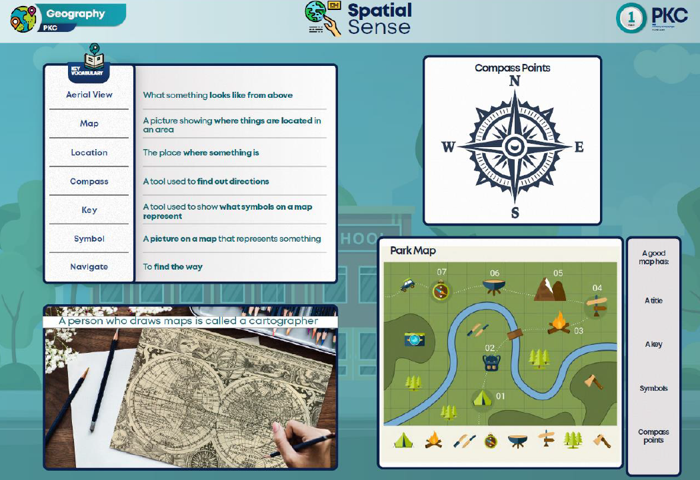

Our curriculum
In Art, Science, History and Geography we use Knowledge Organisers to support the children in remembering the key information they will need to remember for each topic. These are available on the school website so that you can look at them with your children at home. You can even quiz your children about different sections.

Slide 18
Home Learning
Maths workbook- Week 2
Daily reading – Reading Records must be signed daily
Spelling Shed weekly
Numbots weekly
Homework expectations: Every child will bring their homework on time and at a high standard. Every child will follow the school rules for presentation.
Children who do not complete their homework will attend homework club. This is designed, not as a punishment, but as a second opportunity to complete the work with support from an adult.
If your child is struggling to complete homework at home, please let us know so that we can arrange for them to attend homework club.

Slide 19

Assessment
Spelling test – Weekly
Reading and Maths assessments – Termly
Reading ages and spelling ages - Termly
Each lesson is assessed using our SOLO colours. This information is used by children and teachers to shape future learning. SOLO colours are used in all subjects for Assessment for Learning (AFL).

Slide 20
How can you help your child?
- Read daily
- Access spelling shed together
- Practice letter formations
- Practice number formations
- Encourage imaginative play

Slide 21
Dates for your diary- Autumn Term
Friday 3rd October 3.00-3.30pm– Stay and Read (R to Y6)
Thursday 2nd October – Census Day Pyjamas Dress up
Wednesday 15th October - Learning Review Day
Friday 10th October - Year 6 class assembly (Year 6 parents only)
Thursday 23rd October – Harvest performance (Years 1 & 2 only)
Friday 24th October - October half term (2 weeks)

Slide 22
How we can help
Here to talk to, here to help!
- Best to make an appointment, difficult to catch up when dismissing children, etc.
Support with uniform for low-income families, Foodbank vouchers, advice (all dealt with very confidentially). Please make an appointment with Mrs Foster

Slide 23
Thank you for your continued support

Slide 24
Questions
We would love to help and make sure that parents are up to date and feel supported.

