Slide 1

Welcome to Year 4 Woodpecker’s
‘Meet the Teacher’

Slide 2

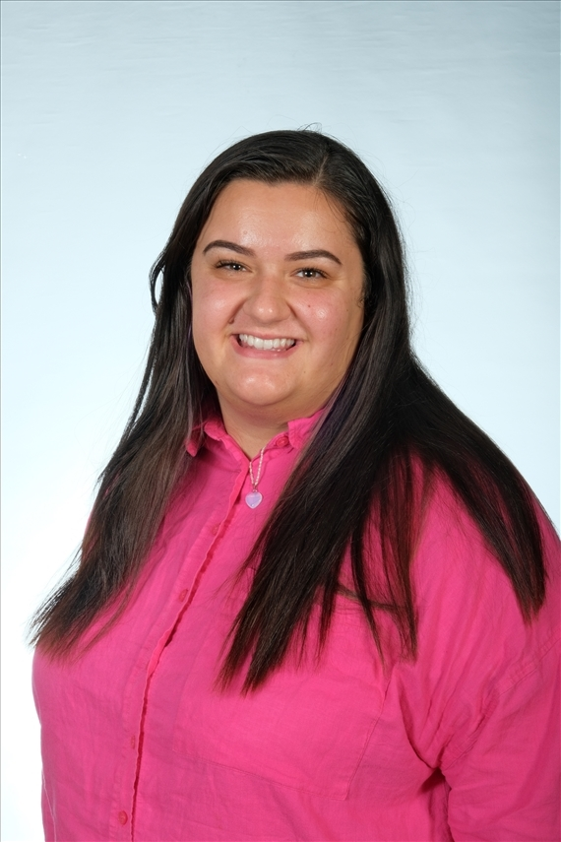
Meet the staff
Year 4 Woodpecker teacher is Mrs Muller.

Slide 3
Timings of the day
The school opens at 8.35. We use this 'soft start' time in the morning to support children and get them ready for the day so that we can start lessons promptly at 8.45.
The school gates will close at 8.45 sharp. Any children arriving after this time will have to report as late through the front office.
Parents and Carers leave children at the building door. If you have a message, please pass it on either to the Support staff on the door, or to the main school office.

Slide 4
Timings of the day
Playtime in Year 4 is at 10:15
Lunch time is 12.15
Home time is 3:30pm , Wednesday is 2:15pm

Slide 5
Uniform and PE kits
At Foxborough, we have high expectations for school uniform.
Full school uniform must be worn each day, unless you have been informed of a special day.
Uniform includes black shoes (no trainer, no logos).
PE kits should be worn to school on PE days. Our PE day is Wednesdays.
Jewellery is not permitted at school. For safety reasons, earrings must be removed for PE lessons.
Children not in the correct uniform will receive a letter for their parents.
We hold uniform swap shops regularly where families can buy second-hand uniform
If you are struggling to provide the correct uniform please contact Mrs Foster (advice@foxboroughprimary.co.uk)

Slide 6

Values
These are our school values. We launched these with the children last year and will be continuing to live them and embed them into our school culture.

Slide 7
Our year group responsibility is...
Assembly Champions!

Slide 8
Our school performance will be...
Easter performance with Year 3

Slide 9
Our year group opportunity is...
Artist in residence

Slide 10

Behaviour
We promote positive behaviour by awarding tokens.
On the rare occasion it is necessary, a Response 1, 2 or 3 by be used as point for children to reflect on their behaviour and to discuss their behaviour with an adult.
We have high expectations of our children and responses will be only be issued after a number of reminders have been given and children have had the opportunity to ‘repair’ the situation.

Slide 11
Behaviour
If a response needs to be issued they will follow this format:
Response 1 – Verbal warning
Response 2 – Class-based consequence
Response 3 – Further support such as another member of staff to come into class or the child visits another member of staff (10 mins max).
You will receive a text if your child is issued with a response and any child issued a Response 3 will require you to have meeting with the class teacher to plan how we can together support your children in making the right choices going forward.

Slide 12
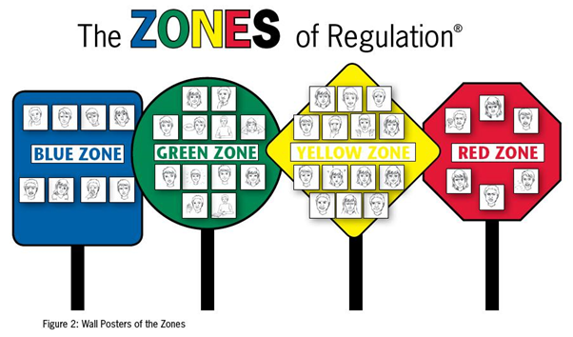
Zones of regulation toolkits
We teach children to recognise how they are feeling so that they can learn to self-regulate.

Slide 13
Our curriculum
Please see our website each term for our curriculum overviews for each subject.
These are our topics for the first half term:
History- Ancient Greece
Geography – Our local area
Science- Human Body
Art- Light
In English we will be starting with the book Alice in Wonderland
In maths we will be learning about Place value and addition and subtraction. Working on the fluency, reasoning and problem solving skills. Also, we will focus on times tables.

Slide 14
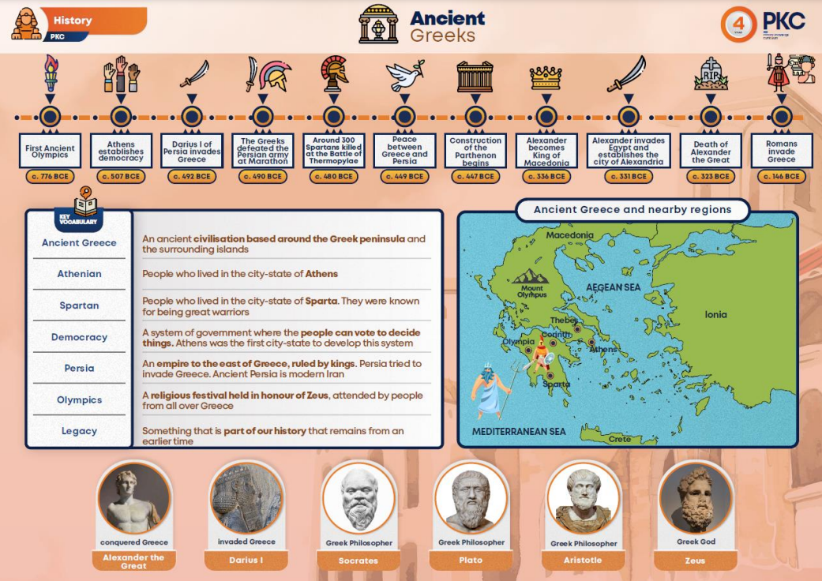

Our curriculum
In Art, Science, History and Geography we use Knowledge Organisers to support the children in remembering the key information they will need to remember for each topic. These are available on the school website so that you can look at them with your children at home. You can even quiz your children about different sections.

Slide 15
Home Learning
Reading workbook- Week 1
Maths workbook- Week 2
Daily reading
Spelling Shed
Times Tables Rockstars
Homework expectations: Every child will bring their homework on time and at a high standard. Every child will follow the school rules for presentation.
Children who do not complete their homework will attend homework club. This is designed, not as a punishment, but as a second opportunity to complete the work with support from an adult.
If your child is struggling to complete homework at home, please let us know so that we can arrange for them to attend homework club.

Slide 16

Assessment
Times tables check - Daily and termly
Spelling test – Weekly
Reading, SPAG and Maths assessments – Termly
Each lesson is assessed using our SOLO colours. This information is used by children and teachers to shape future learning. SOLO colours are used in all subjects for Assessment for Learning (AFL).

Slide 17
How can you help your child?
Read daily
Label uniform
Practice times tables
Raise any concerns with school
Ensure homework is completed on time

Slide 18
Dates for your diary- Autumn Term
Tuesday 1st October – Stay And...
Thursday 3rd October – Census Day Pyjamas Dress up
Wednesday 16th October - Learning Review Day
Friday 25th October - October half term (2 weeks)

Slide 19
How we can help
Here to talk to, here to help!
- Best to make an appointment, difficult to catch up when dismissing children, etc.
Support with uniform for low income families, Foodbank vouchers, advice (all dealt with very confidentially). Please make an appointment with Mrs Foster

Slide 20
Thank you for your continued support

Slide 21
Questions
We would love to help and make sure that parents are up to date and feel supported.

